Slide 1



Cognitive Robot Programming using Procedural Parameters and Complex Event Processing
2016 IEEE International Conference on Simulation, Modeling, and Programming for Autonomous Robots
Session W-3: Machine Learning and Middleware for Robotics
Floris Erich, Kenji Suzuki
University of Tsukuba

Slide 2
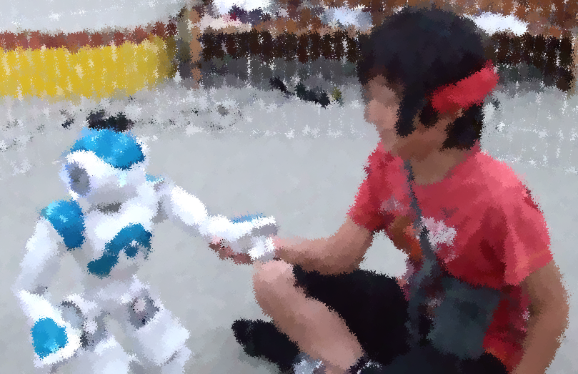
Research overview
An experiment in Socially Assistive Robotics
Drawbacks of having seperate developer, operator and therapist:
Higher cost
Slower speed due to coordination overhead
Higher chance of errors being made
Hence, ideally the therapist would be able to develop and operate the robot on his own
Preparation
Conducting
instructions
interaction
Developer
Operator
User (therapist)
Experiment area
commands
feedback
writes software for
Robot
interaction
Subject

Slide 3
Research objectives
Expand the programming capabilities of end-users
Evaluate the usage of the reactive paradigm for robotics
Implement a robot control architecture based on the reactive paradigm
Contribution of this paper:
Implemented a concrete example robot application using the reactive programming paradigm

Slide 4
Related work: Choregraphe
Graphical interface for programming robots from Softbank
Components are called boxes and have input and output ports
Special ports for starting, stopping and pausing a box
Boxes can contain a subgraph, Python code or a choreography
Box
Start Port
Output Port
Data Port
Stop Port
Output Port

Slide 5
Related work: Targets-Drives-Means (Berenz and Suzuki, 2014)
Hybrid deliberative / reactive architecture (Arkin, 1998)
Focused on end user development
Schemas are representations of external properties
Programs execute behaviors when their schema is active
If multiple behaviors are to be executed their execution is prioritized using a score calculator
Behaviors execute action units
Action units are pairs of an actuation function and an activation condition
Functions are called if their condition applies
Program
Schema
Behavior
Score calculator
Action unit
Condition
Function

Slide 6
Related work: Robot Operating System (Quigley et al., 2009)
Collection of packages and tools for controlling robots
We are mainly interested in the ROS Graph
Nodes are units of computation
Nodes communicate using messages
Messages are passed using topics
1. subscribe
Node n
2. publish
Topic t
3. push
Node n’

Slide 7
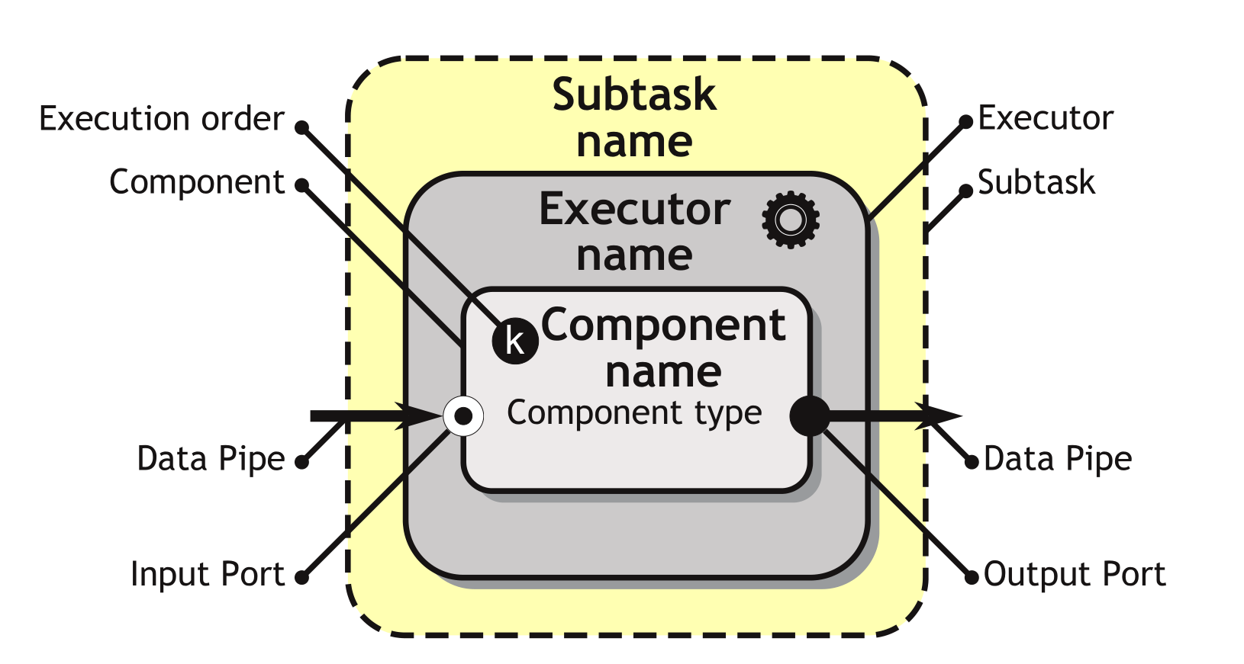
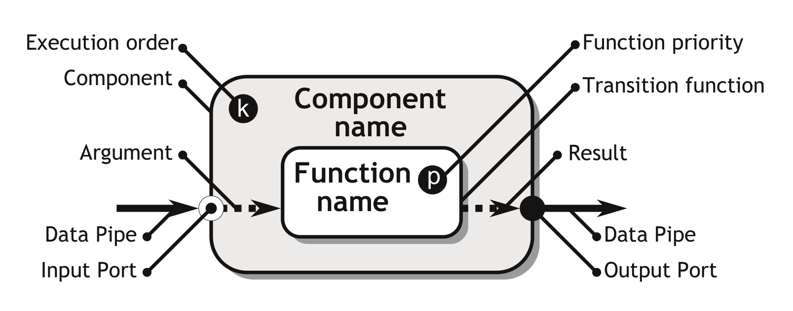
Related work: DisCODe (Stefanczyk and Kornuta, 2014)
Distributed Component Oriented Data Processing
Behavior is contained in components
Components are connected using arrows

Slide 8
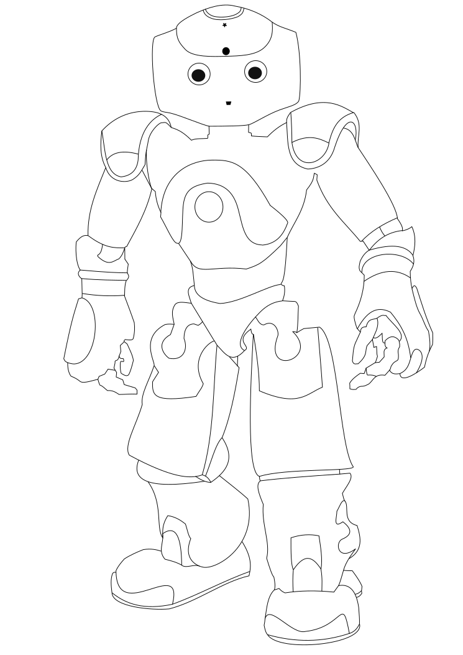
Cognitive Robot Programming
Robots are embedded into a partly uncontrollable environment
The alignment between an environment, the robot hardware and the robot software is complex
Software
input
output
Environment
sensing
Robot
actuation
Notes:
Dexterous robots are robots embedded into an environment
A robot can receive stimuli from the environment (sensing) and send a response back (actuation)
Software receives stimuli from the robot, performs cognition, and sends the response to the robot
The DevOps approach can be used to support alignment of the software with the hardware embedded into an environment

Slide 9
Complex Event Processing
Low level robot behaviors can be separated into three tasks (Arkin, 1998):
Sensing
Computation/planning
Acting
Typically components are created for each task and connected using middleware
Push behavior can be created using the Observer Design Pattern (Gamma et al., 1994)
The observer pattern can be extended to function over streams of events instead of single items (Maier and Odersky, 2012; Meijer; 2012)
Data flow between components is specified using connectors (Taylor, Medvidovic and Dashofy, 2008)

Slide 10
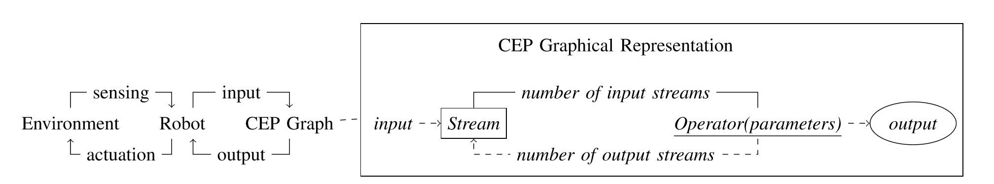
CEP Graphical Representation
We propose a graphical representation for designing and developing low level robot behaviors: The CEP Graph

Slide 11
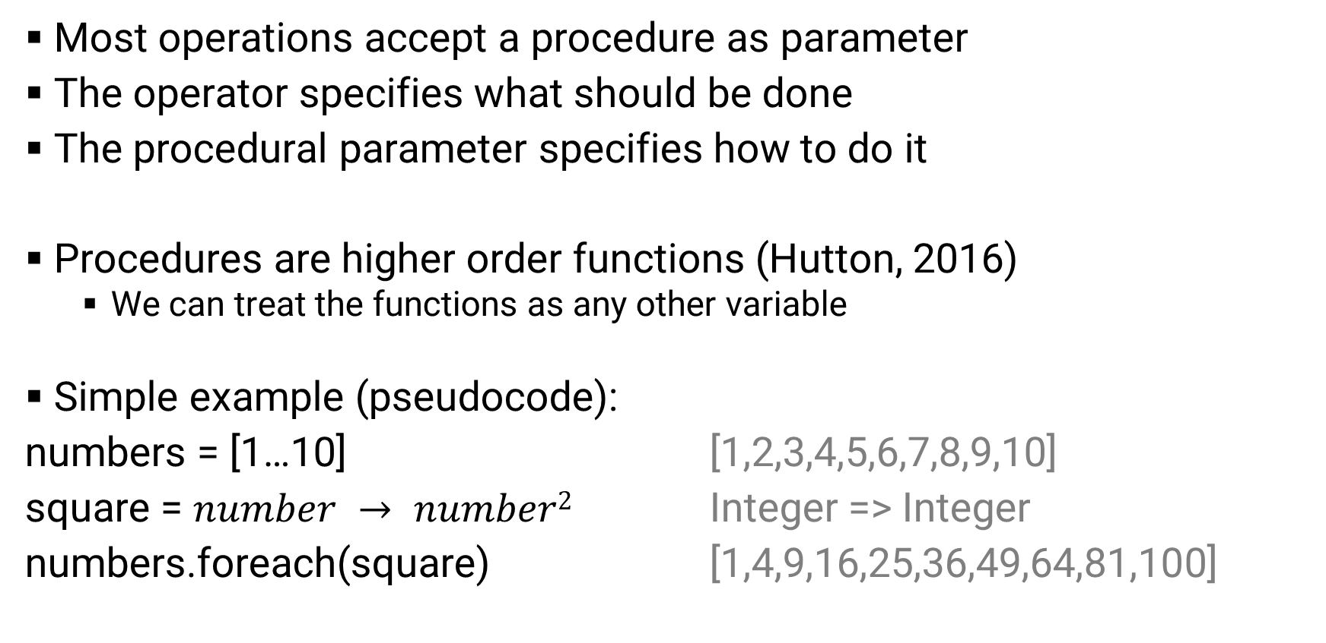
Procedural parameters
Most operations accept a procedure as parameter
The operator specifies what should be done
The procedural parameter specifies how to do it
Procedures are higher order functions (Hutton, 2016)
We can treat the functions as any other variable
Simple example (pseudocode):
numbers = [1…10] [1,2,3,4,5,6,7,8,9,10]
square = $number → number2$ Integer => Integer
numbers.foreach(square) [1,4,9,16,25,36,49,64,81,100]

Slide 12
Architecture
Control PC
IPython¹ Notebook
CEP Graph
Sensor
Sensor
Reactive Extensions²
Sensor
Sensor
Sensor
Actuator
NAO
naoqi
DCM
1: www.ipython.org
2: https://github.com/ReactiveX/RxPY

Slide 13
Example application
Make the robot:
Track far away objects with its head
Track medium distance objects with its head and its body
Track close distance objects with the arm closest to the object

Slide 14
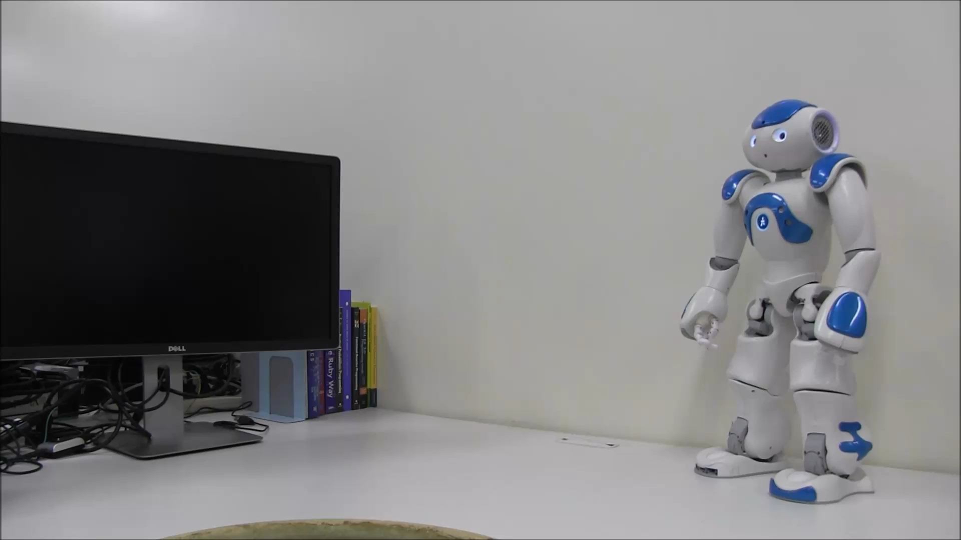
Demonstration

Slide 15
Intuitive implementation
Object
far away
medium distance
close
Head tracker
Head and body tracker
Arm tracker

Slide 16
Intuitive implementation: Object distance
Ball
Ball distance > 50 cm
Ball distance > 20 cm and <= 50
Ball distance <= 20 cm
Head
Head + body
Arm

Slide 17

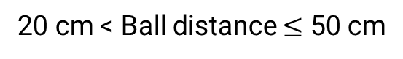
Intuitive implementation: Left or right arm
Ball
Ball distance $≤$ 20 cm
Ball left of torso
Ball right of torso
Ball distance > 50 cm
20 cm < Ball distance $≤$ 50 cm
Head
Head + body
Left arm
Right arm

Slide 18
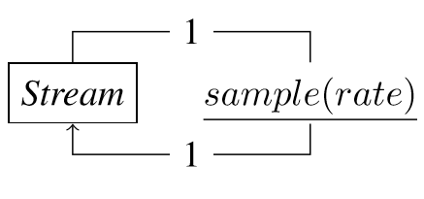
Implementation: Sampling
Avoid that the robot changes tracking modes too many times in a certain time period
Reduce the amount of computation
Ball
sample(50)
BallSamples
(d) Sample: On an interval specified by the sample rate, take the latest value from the input stream and put this into the output stream

Slide 19
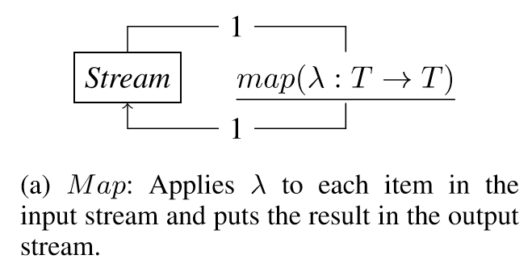
Implementation: Distance to ball
size = …
def dist2(width, height):
return (1/4.) ∗ ( size/tan(width) + size/tan(height) )
def ball_distance(ball):
return dist2(ball.width, ball.height)
BallSamples
map(ball_distance)
Distance

Slide 20
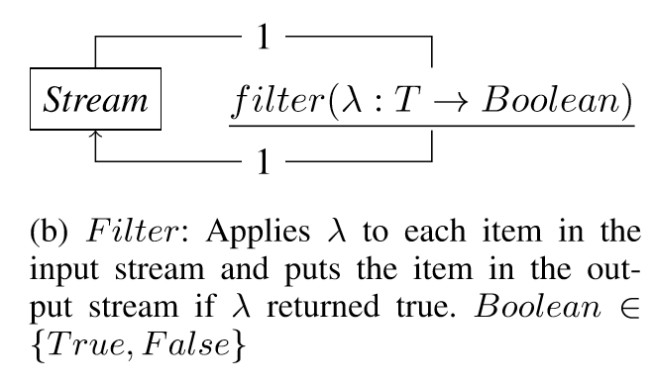
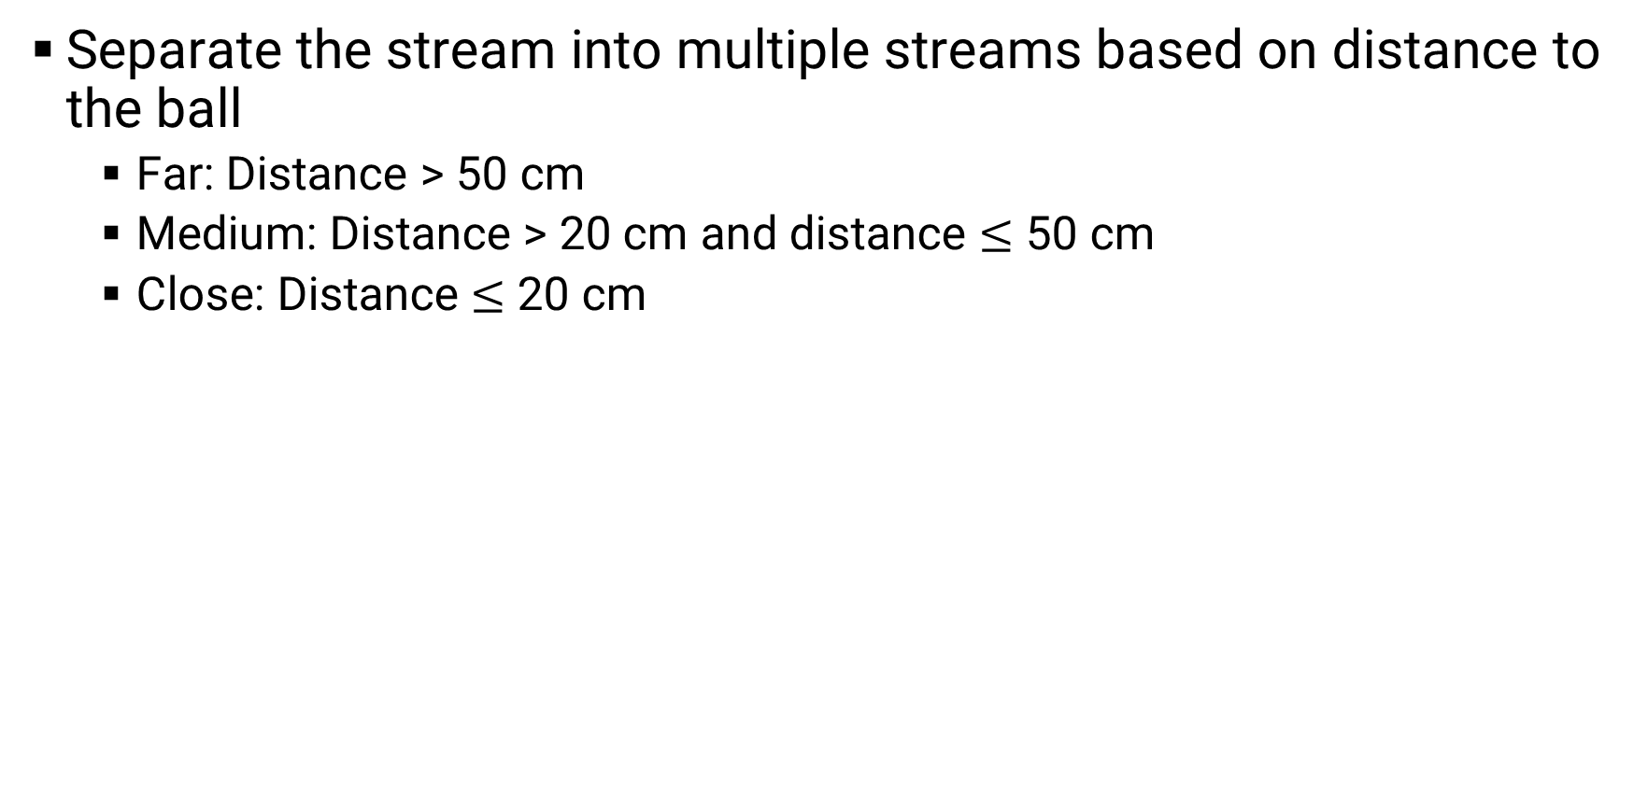
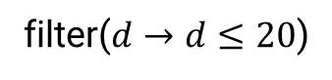


Implementation: Filter based on distance
Separate the stream into multiple streams based on distance to the ball
Far: Distance > 50 cm
Medium: Distance > 20 cm and distance $≤$ 50 cm
Close: Distance $≤$ 20 cm
Head
filter($d→d>50$)
Distance
filter($d→20<d≤50$)
Head + body
filter($d→d≤20$)
Arm

Slide 21
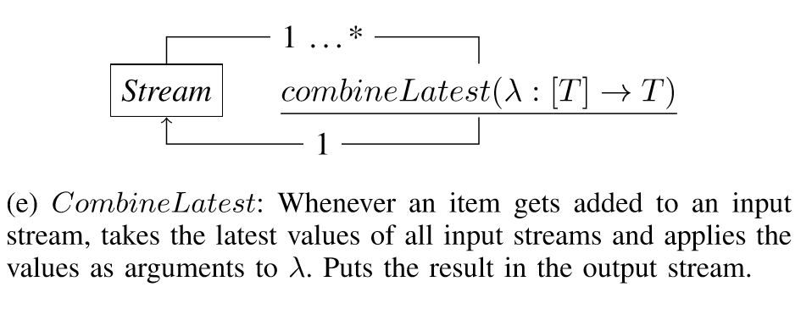
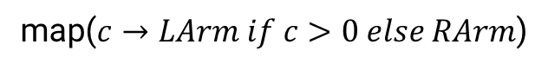
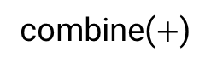
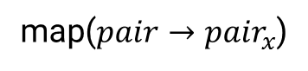
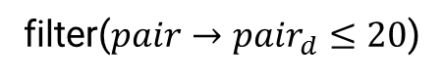
Implementation: Determining the arm
Transform ball location in camera frame to torso frame
We only need to know if the horizontal position is to the left or to the right of the torso
Simple solution: Take the sum of the angle of the head yaw and the ball angle
BallSamples
map($ball →\{x:{ball}_{x}, d:dist2\left({ball}_{width},{ball}_{height}\right)\}$)
filter($pair→{pair}_{d}≤20$)
map($pair→{pair}_{x}$)
BallX
Head yaw
combine($+$)
map($c→LArm if c>0 else RArm$)
Arm
(e) CombineLatest: Whenever an item gets added to an input stream, takes the latest values of all input streams and applies the values as arguments to λ. Puts the result in the output stream.

Slide 22
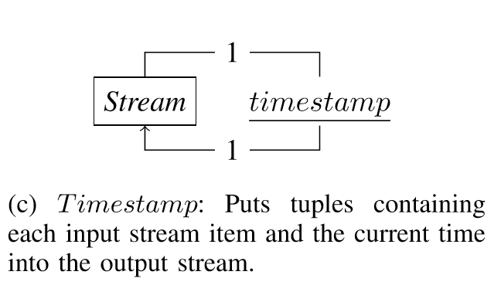
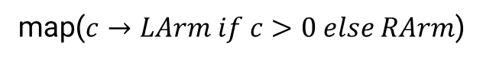
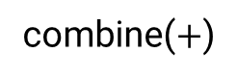
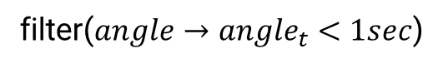
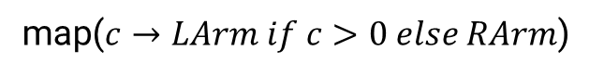
Implementation: Dealing with old data
CombineLatest takes the latest value from a set of streams
There can be a large time difference between the insertion times of the item in each stream
Head yaw always contains the most up to date value, but the value of the ball stream might be outdated
BallX
Head yaw
combine($+$)
map($c→LArm if c>0 else RArm$)
Arm
BallX
Head yaw
timestamp
timestamp
combine($hy,ba→\{θ:hy_{val}+ba_{val},t:hy_{t}−ba_{t}\}$)
filter($angle→{angle}_{t}<1sec$)
map($c→LArm if c>0 else RArm$)
Arm

Slide 23
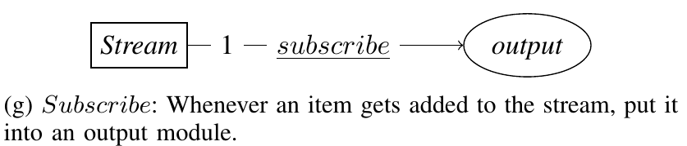
Implementation: Controlling the trackers
Assume we have the following actuation modules:
head_tracker: On input switches tracking mode to head
head_body_tracker: On input switches tracking mode to head and body
arm_tracker: Takes as input a string representing the arm to use, switches to tracking with that arm
head_tracker
Head
subscribe
head_body_ tracker
Head + body
subscribe
arm_tracker
Arm
subscribe

Slide 24
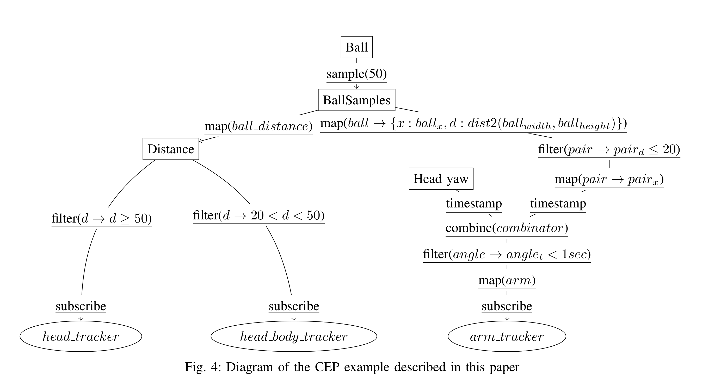
Complete implementation

Slide 25
Discussion and conclusion
CEP with Procedural Parameters reduces boilerplate code and standardizes terminology using operators
Less developer effort
Less bugs
Solution is suitable for developing mid level robot behaviors
Currently we are exploring integration with high level behavior engines
Low level modules such as sensors, actuators and complex operations are supplied by a library created by robotics experts
We have shown the approach works through a simple example
Performance with more complex programs needs to be evaluated
Intuitiveness of the approach has to be validated through a user study

Slide 26
References
R. C. Arkin, Behavior-based Robotics, 1st ed., Cambridge, MA, USA: The MIT Press, 1998.
V. Berenz and K. Suzuki, “Targets-drives-means: A declarative approach to dynamic behavior specification with higher usability,” Robotics and Autonomous Systems, vol. 62, no. 4, pp. 545–555, 2014.
E. Gamma, R. Helm, R. Johnson, and J. Vlissides, Design Patterns: Elements of Reusable Object-Oriented Software. Addison-Wesley Professional. 1994.
G. Hutton, Programming in Haskell, Second Edition. Cambridge University Press. 2016.
I. Maier and M. Odersky, “Deprecating the Observer Pattern with Scala.react,” Tech. Rep., 2012.
E. Meijer, “Your mouse is a database,” Communucations of the ACM, vol. 55, no. 5, pp. 66–73, May 2012.
M. Quigley, K. Conley, B. P. Gerkey, J. Faust, T. Foote, J. Leibs, R. Wheeler, and A. Y. Ng, “Ros: an open-source robot operating system,” in ICRA Workshop on Open Source Software, 2009.
M. Stefanczyk and T. Kornuta, “Handling of asynchronous data flow in robot perception subsystems,”, SIMPAR 2014.
R. N. Taylor, N. Medvidovic and E.M. Dashofy, Software Architectures: Foundations, Theory and Practice”, John Wiley & Sons, 2008.

